Slide 1

Yapay Zeka
Phd. Yahya İZALA

Slide 2
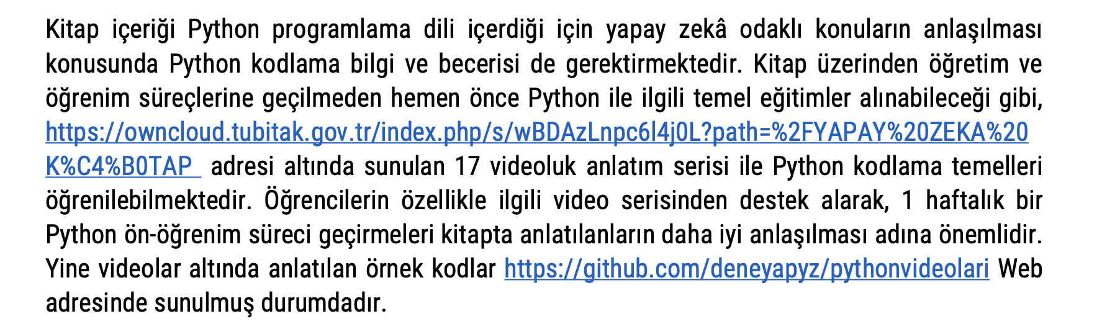
Python Öğrenmek İçin Kaynak

Slide 3
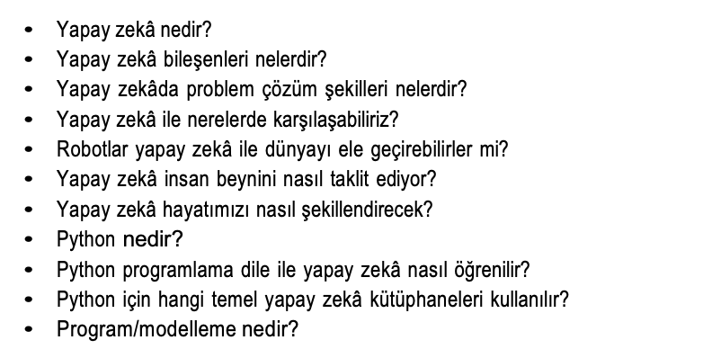

Slide 4
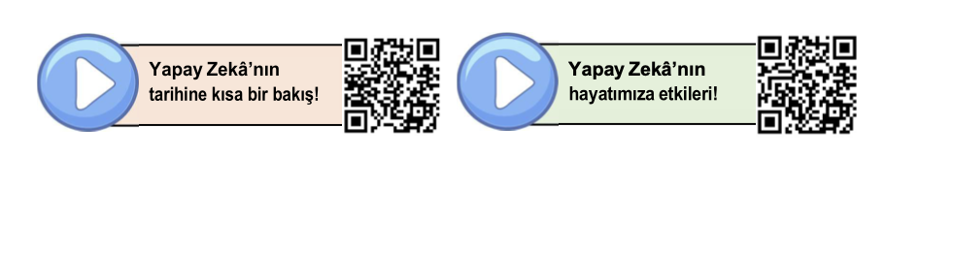
Tarihçe İçin QR Kod

Slide 5
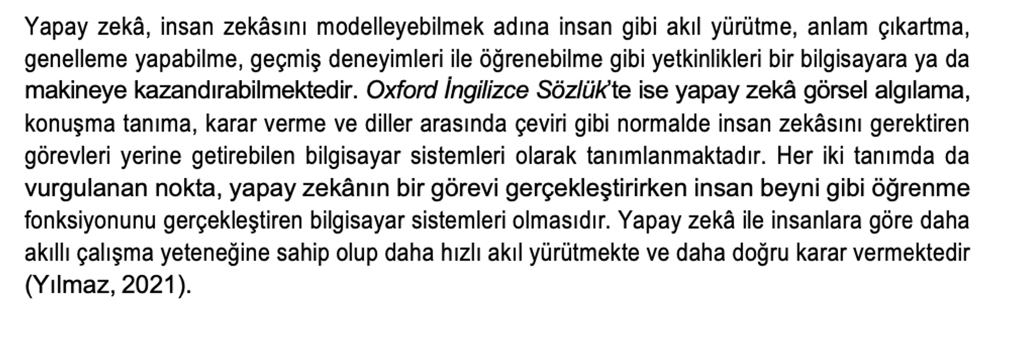
Yapay Zeka Nedir

Slide 6
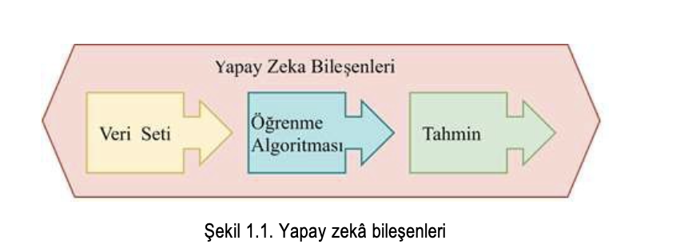
YZ Bileşenleri

Slide 7
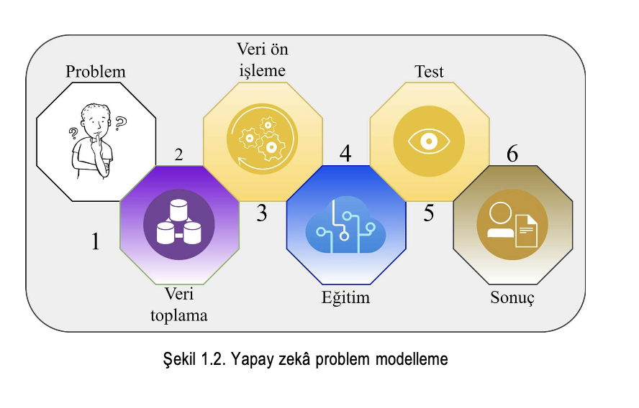
YZ Problem Modelleme

Slide 8
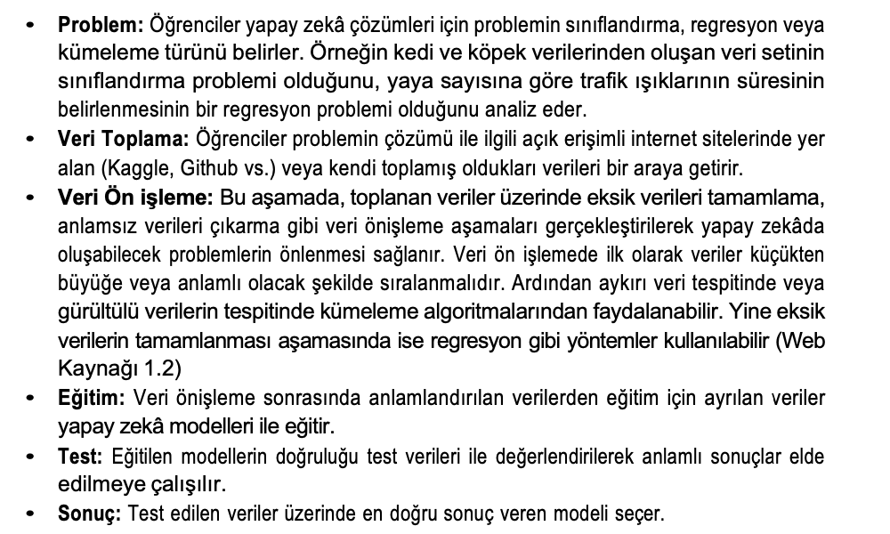
YZ Problem Modelleme

Slide 9
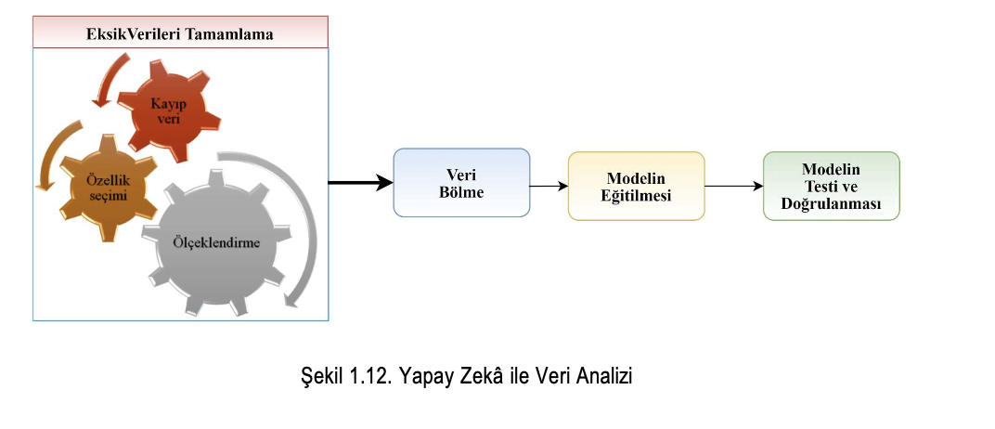
YZ Eksik / Görültülü Verileri Tamamlama

Slide 10
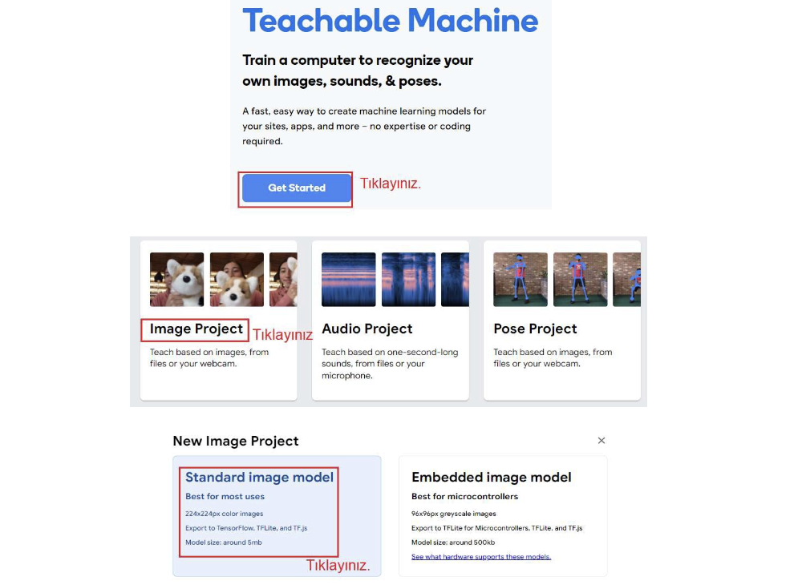
Taş Kağıt Makas

Slide 11
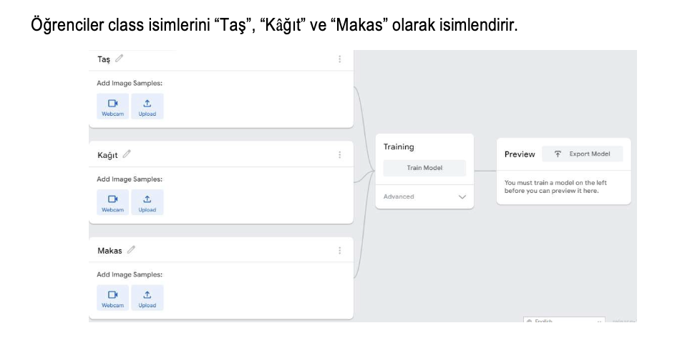
Taş Kağıt Makas

Slide 12
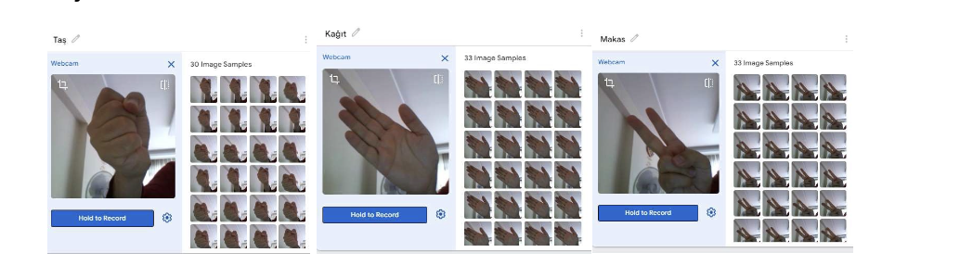
Taş Kağıt Makas

Slide 13
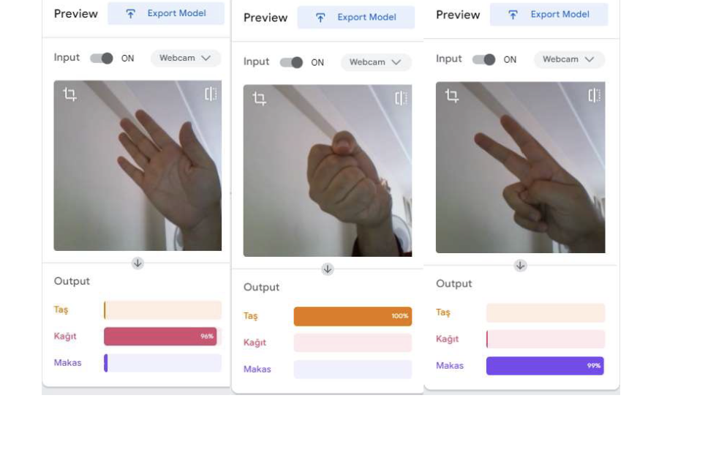
Taş Kağıt Makas

Slide 14
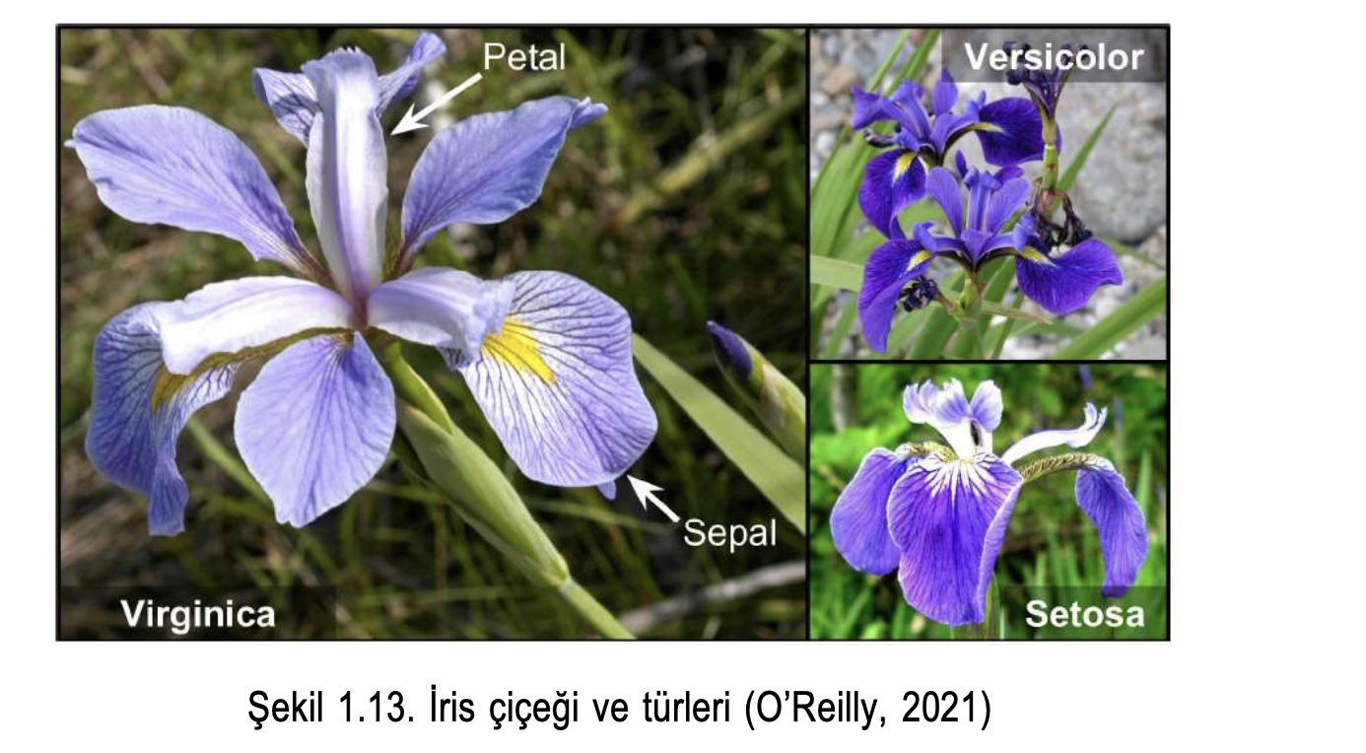
İris Çiçeği

Slide 15
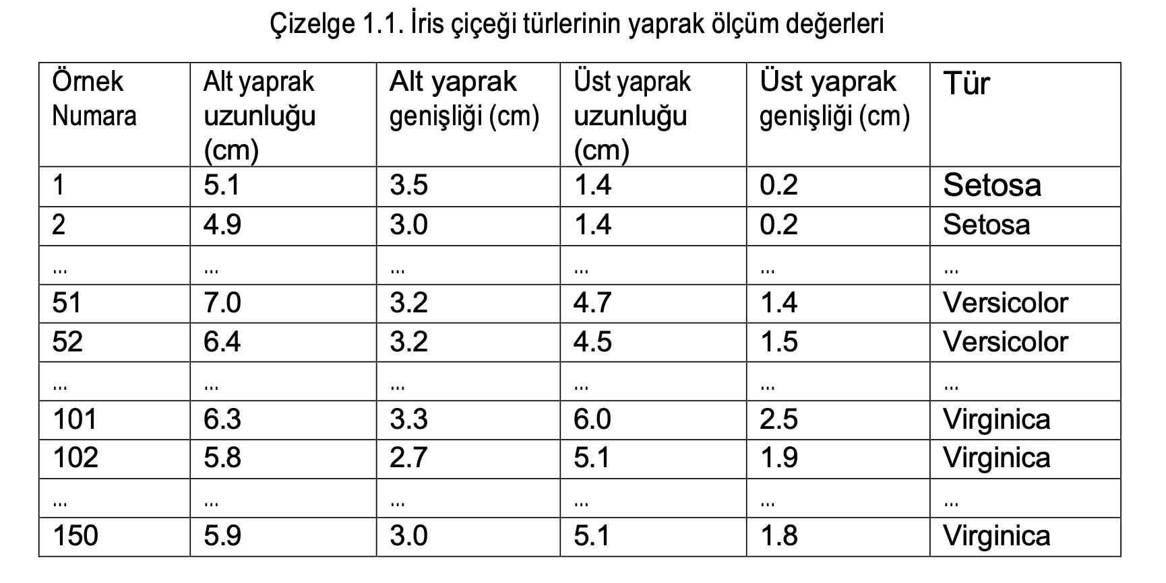
Ölçü Tablosu

Slide 16
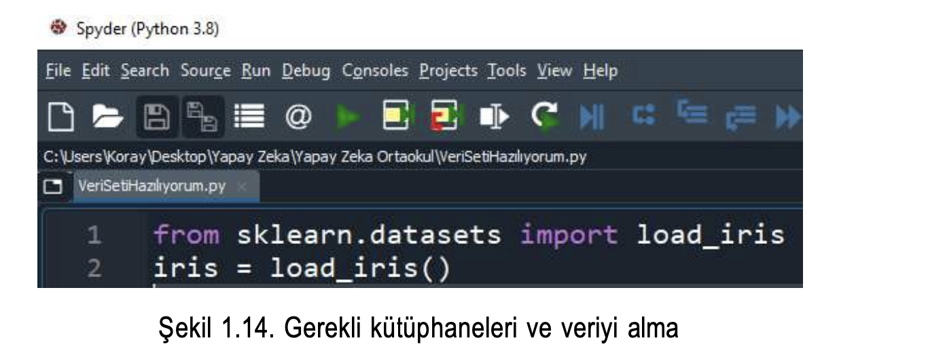

Slide 17
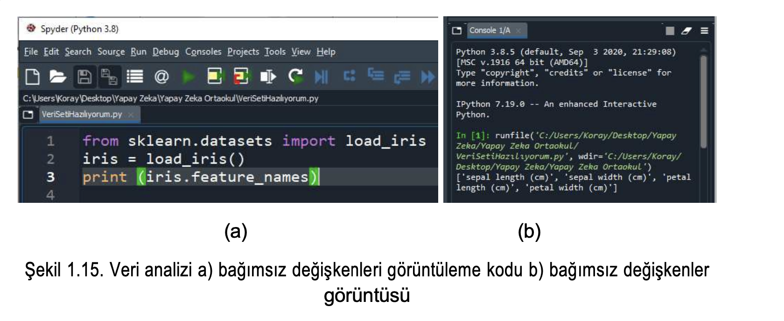

Slide 18
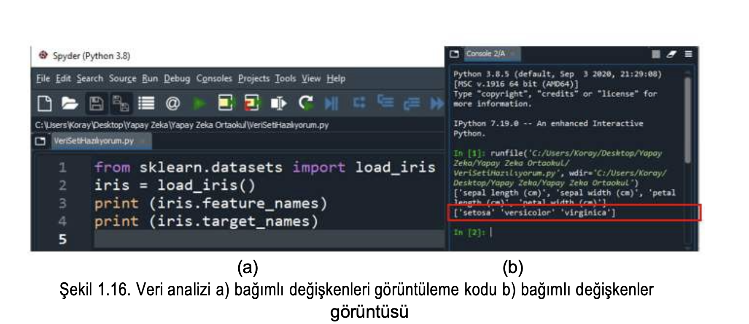

Slide 19
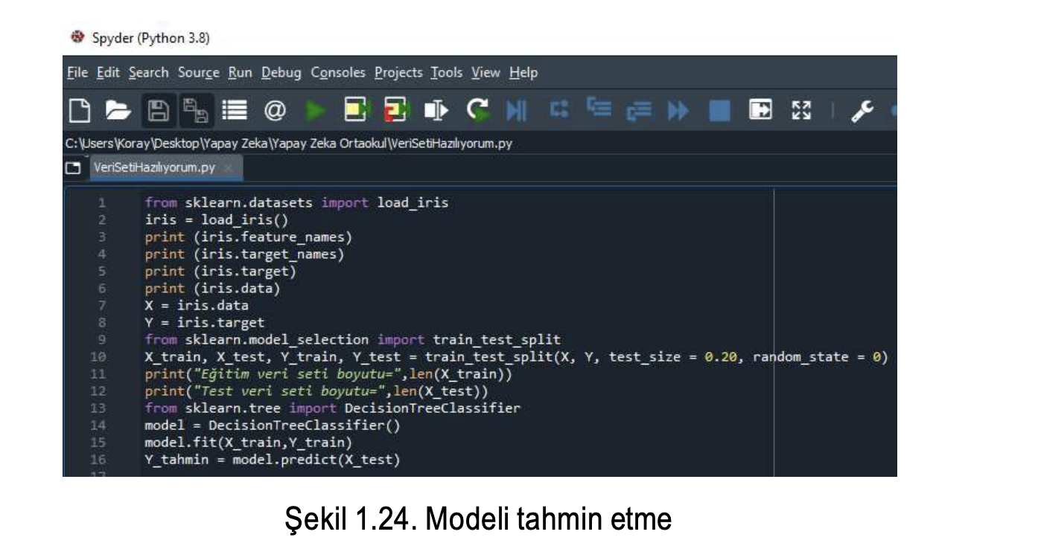

Slide 20
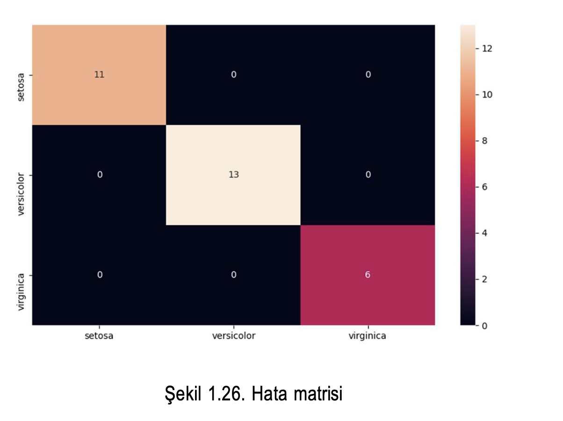
Confusion Matrix

Slide 21
Kodların Tam Metni
from sklearn.datasets import load_
iris iris = load_iris()
import seaborn as sns import pandas as pd import matplotlib.pyplot as plt print (iris.feature_names) print (iris.target_names)
print (iris.target) print (iris.data) X = iris.data Y = iris.target
from sklearn.model_selection import train_test_split X_train, X_test, Y_train, Y_test = train_test_split(X, Y, test_size = 0.20, random_state = 0) print("Eğitim veri seti boyutu=",len(X_train)) print("Test veri seti boyutu=",len(X_test)) from sklearn.neighbors import KNeighborsClassifier model = KNeighborsClassifier () model.fit(X_train,Y_train) Y_tahmin = model.predict(X_test) from sklearn.metrics import confusion_matrix hata_matrisi = confusion_matrix(Y_test, Y_tahmin) print(hata_matrisi) index = ['setosa','versicolor','virginica'] columns = ['setosa','versicolor','virginica'] hata_goster = pd.DataFrame(hata_matrisi,columns,index) plt.figure(figsize=(10,6)) sns.heatmap(hata_goster, annot=True)
plt.show()

